Slide 1
Getting Started with React Native Development
Chapter 13 – Getting Started with React Native Development

Slide 2
Getting Started with React Native Development
Getting Started with React Native Development
React Native allows you to build mobile apps using JavaScript/TypeScript and React
It lets you create apps for both Android and iOS from a single TypeScript codebase
To get started, you set up the environment with Node.js, Java 17, Android Studio, and VS Code
Using TypeScript improves code safety, scalability, and developer experience while React Native provides native performance for mobile apps

Slide 3
Getting Started with React Native Development
Expo and React Native CLI
Expo and React Native CLI are tools that help in building React Native apps
Both supports TypeScript for React Native development
Expo:
It is a toolset and platform built on top of React Native
It provides an easier and faster way to develop and build React Native applications with a focus on simplicity, using pre-configured libraries and tools
It fully supports TypeScript for React Native development
Expo handles TypeScript configuration for you, including installing necessary dependencies and creating a tsconfig.json file
When a new project is created with Expo, TypeScript is automatically configured if .ts or .tsx files are added to the project

Slide 4
Getting Started with React Native Development
Expo and React Native CLI
A .tsx file is a TypeScript file that includes JSX (JavaScript XML) syntax, which is commonly used in React applications
.tsx stands for TypeScript + JSX
It allows you to write React components using TypeScript's type safety and JSX's HTML-like syntax
It's similar to .jsx but specifically designed for TypeScript
React Native CLI:
It is a command-line interface used for setting up and managing React Native projects
It also supports TypeScript for React Native development
It gives developers more control over the configuration, native code, and dependencies, allowing for more customization and flexibility in building apps

Slide 5
Getting Started with React Native Development
Expo and React Native CLI
React Native CLI allows you to work directly with native code (Java, Swift, Objective-C, etc.), giving you the flexibility to use custom native modules and make deeper changes to the app's behavior
It allows developers to write and modify native code for iOS and Android if required
While React Native CLI requires more initial setup and configuration, it is the preferred choice for apps that require complex native functionality and more control over the build process

Slide 6
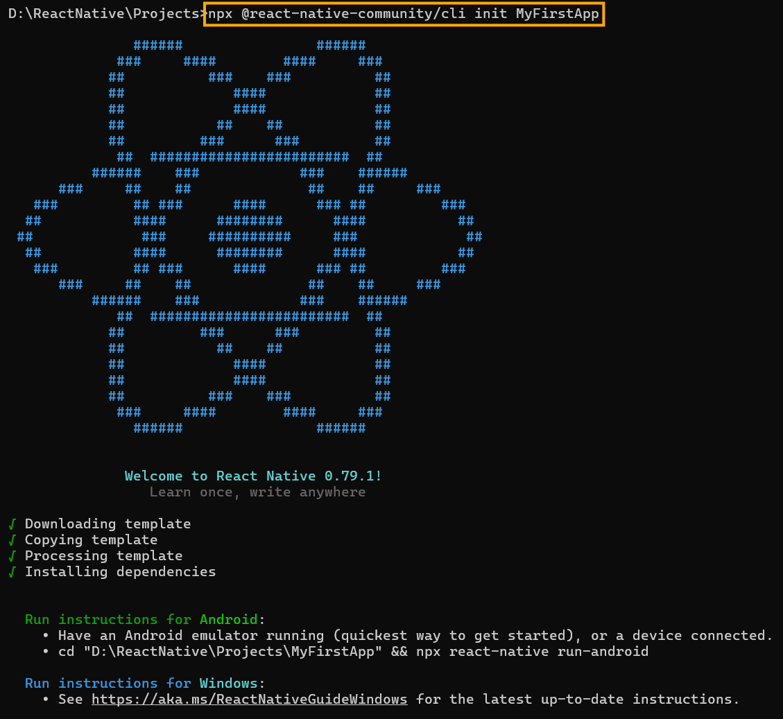
Getting Started with React Native Development
Create a New React Native Project Using React Native CLI
To create a new React Native CLI project, run the following command:
npx @react-native-community/cli init MyFirstApp
Creates a React Native project ‘MyFirstApp’ with TypeScript configured out of the box, including .ts and .tsx files, and a tsconfig.json file

Slide 7
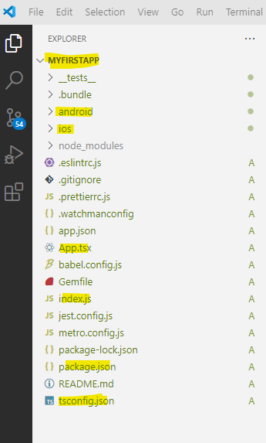
Getting Started with React Native Development
React Native CLI App Structure
Open the project folder ‘MyFirstApp’ in VS Code to learn about the app structure

Slide 8
Getting Started with React Native Development
React Native CLI App Structure
File/Folder | Description
App.tsx | The root React component. This is the entry point of your UI and where your app's main content lives. Written in TypeScript with JSX support (.tsx file).
index.js | The real entry point of the app. It registers the App component with AppRegistry so the native runtime can launch it.
android/ | Native Android project. Used to build and run the app on Android devices or emulators. You can open this in Android Studio if needed.
ios/ | Native iOS project. Used to run the app on iOS devices/simulators (requires macOS and Xcode).
node_modules/ | Auto-generated folder containing all your project’s installed dependencies.
package.json | Lists all dependencies and scripts. The core file for managing packages with npm or yarn.
package-lock.json | Ensures consistent dependency versions across environments when using npm.
tsconfig.json | TypeScript configuration file. It tells the TypeScript compiler how to check and compile .ts and .tsx files.
babel.config.js | Configuration for Babel – it compiles modern JavaScript/TypeScript into code that runs on React Native.
metro.config.js | Configuration for Metro, the JavaScript bundler that ships with React Native.
app.json | Basic configuration like app name, version, and entry file. Used by bundlers and CLI tools.

Slide 9
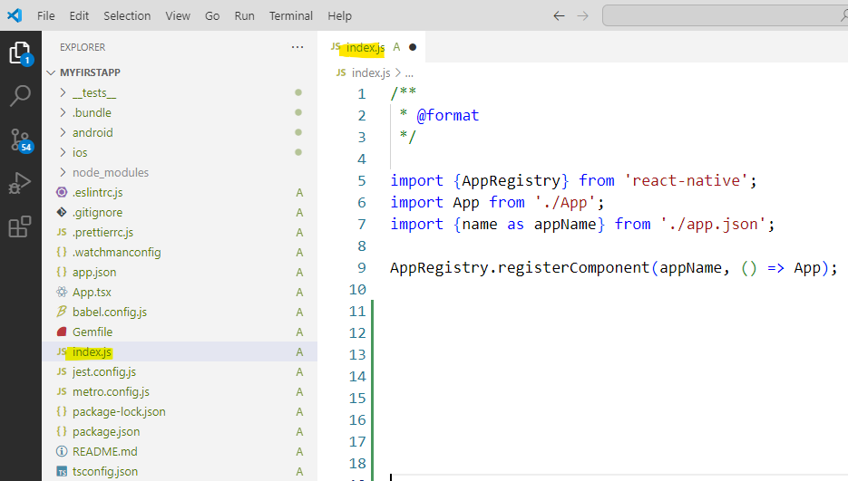
Getting Started with React Native Development
React Native CLI App Structure – index.js
Index.js the launch file that boots your React Native app
It's like main() in other programming languages

Slide 10
Getting Started with React Native Development
React Native CLI App Structure – index.js
Import AppRegistry: A core React Native module that tells the app where to start rendering
Import App: Your main component (App.tsx) where your app’s UI and logic live
Import appName: The name of the app (from app.json). It must match the native code registration
Register the App: AppRegistry.registerComponent(...) connects the native code to your JavaScript app and starts the React Native application

Slide 11
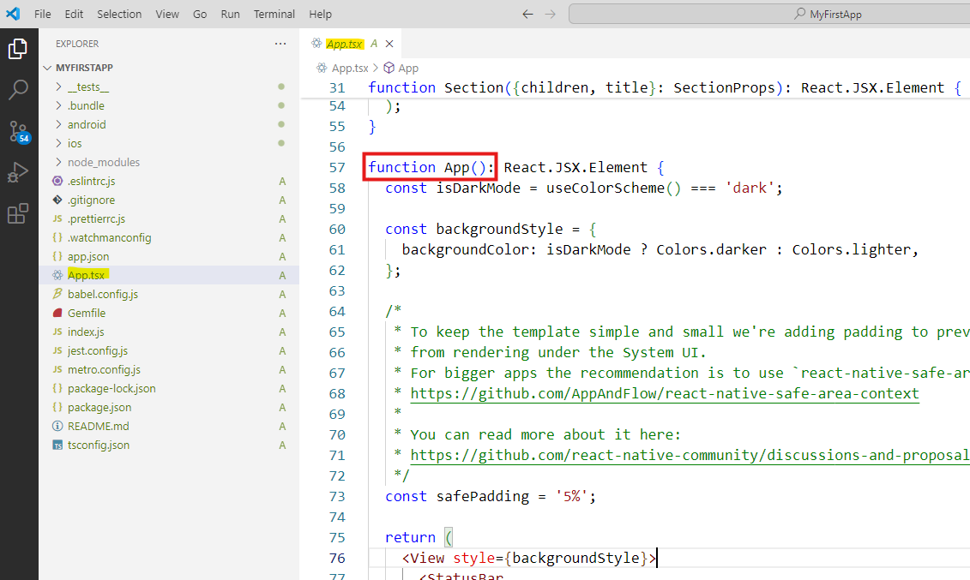
Getting Started with React Native Development
React Native CLI App Structure – App.tsx
App.tsx is the root React component
This is the entry point of your UI and where your app's main content lives similar to index.html in the web apps
It’s Written in TypeScript with JSX support (.tsx file)

Slide 12
Getting Started with React Native Development
Key Parts of App.tsx in React Native
App() function: The main component where your app's UI is built. It returns a tree of React Native components like View, Text, ScrollView, and StatusBar
Section component: A reusable component that shows titled sections with custom styles
useColorScheme(): Detects if the device is in dark or light mode and changes styles accordingly
<Header />, <ReloadInstructions />, <DebugInstructions />, and <LearnMoreLinks />: Pre-built helper components from React Native’s template to guide new developers
Styling with StyleSheet.create(): Central place to define consistent styles for components

Slide 13
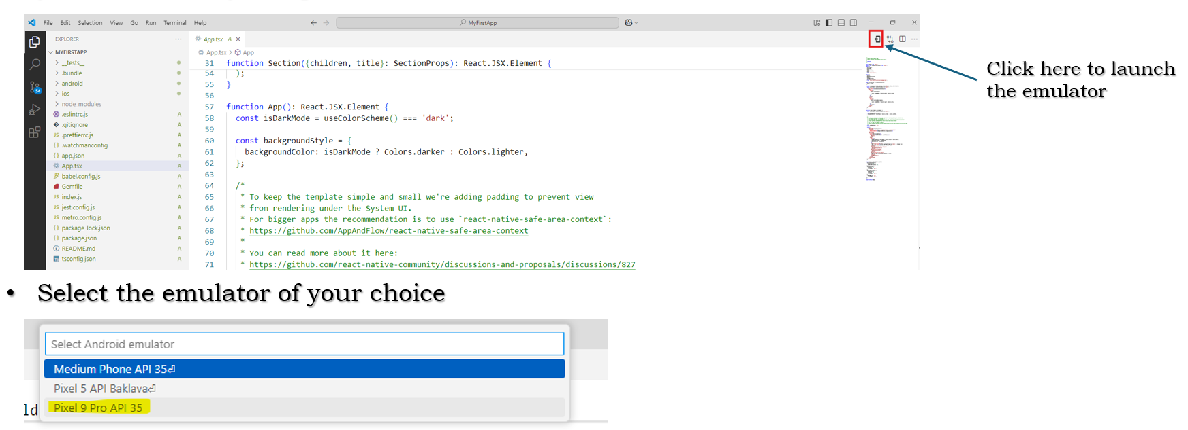
Getting Started with React Native Development
Run the React Native CLI Application
To run the React Native CLI application on an Android emulator, launch the Android emulator that you have already setup from VS code

Slide 14
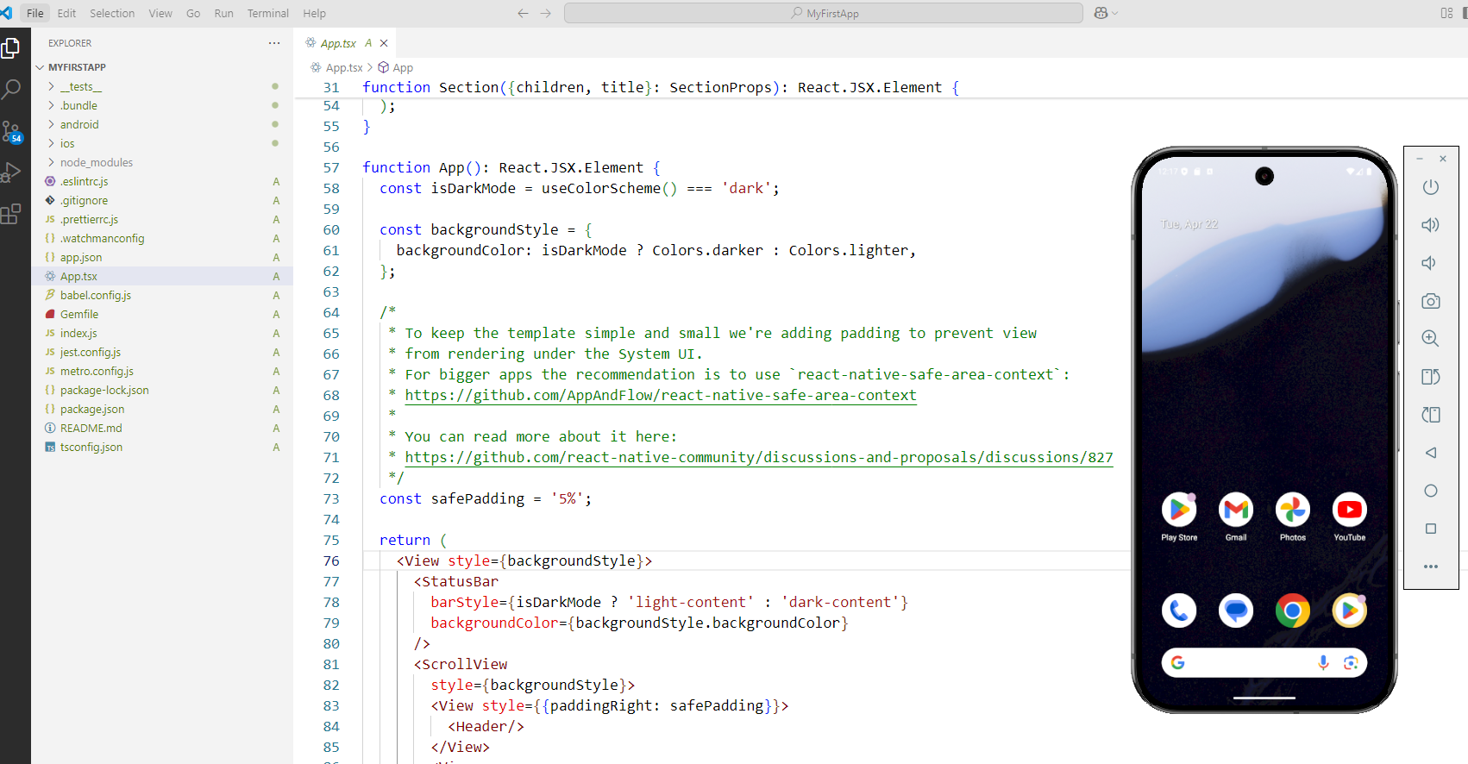
Getting Started with React Native Development
Run the React Native CLI Application
Android emulator is now launched as below:

Slide 15
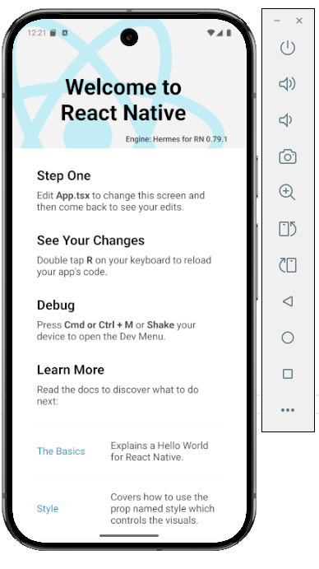
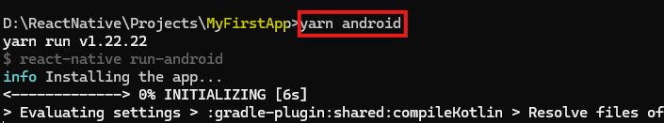
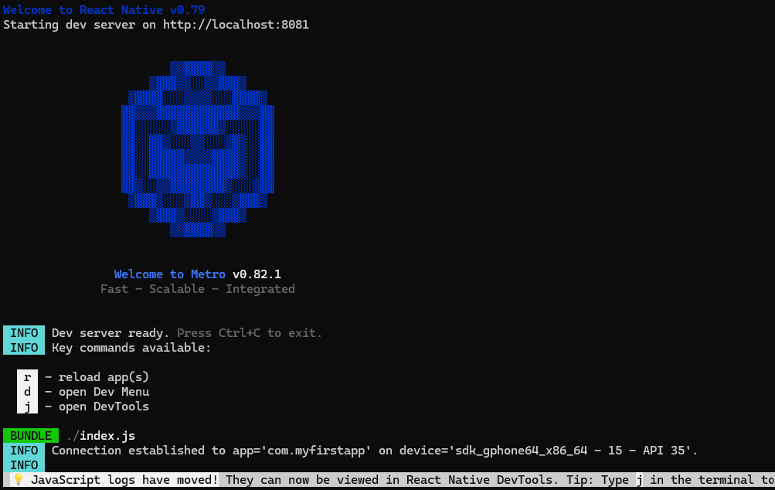
Getting Started with React Native Development
Run the React Native CLI Application
Now to run the application on the Android emulator:
Switch to the directory of the project in command prompt or Power Shell
Execute the below command
yarn android
In a short while, you will see the development server running on the local host
and the app running on the emulator
Note: We can stop the development server by pressing Ctrl + C

Slide 16
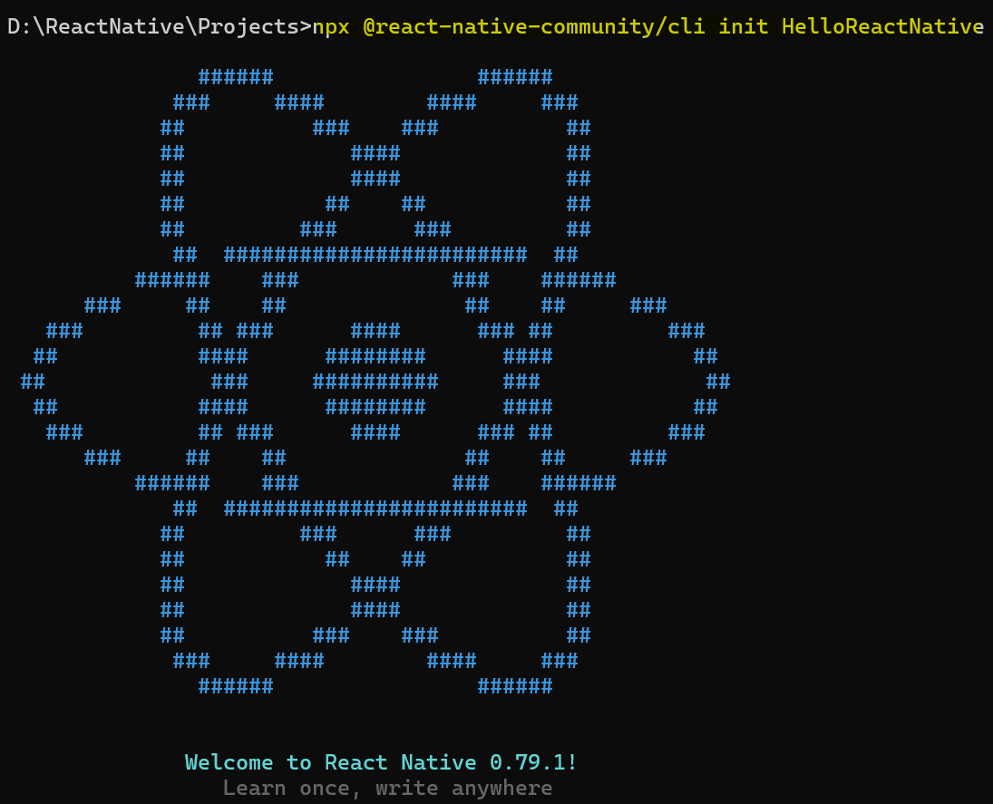
Getting Started with React Native Development
Create a Hello React Native CLI Application
Let’s create a new React Native CLI application named ‘HelloReactNative’
npx @react-native-community/cli init HelloReactNative

Slide 17
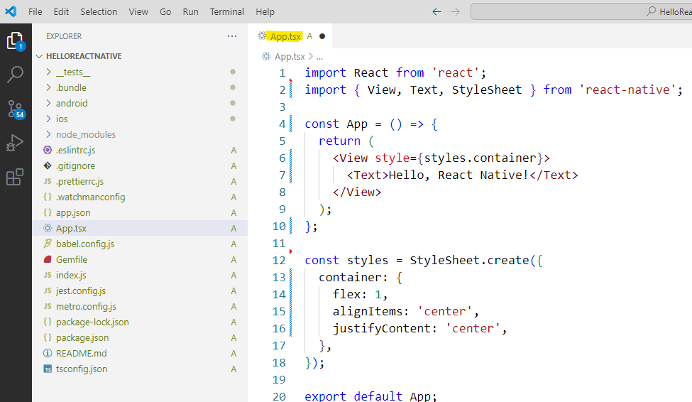
Getting Started with React Native Development
Create a Hello React Native CLI Application
Open the new project in VS Code
Replace everything inside the App.tsx file with the below code:
import React from 'react';
import { View, Text, StyleSheet } from 'react-native';
const App = () => {
return (
<View style={styles.container}>
<Text>Hello, React Native!</Text>
</View>
);
};
const styles = StyleSheet.create({
container: {
flex: 1,
alignItems: 'center',
justifyContent: 'center',
},
});
export default App;

Slide 18
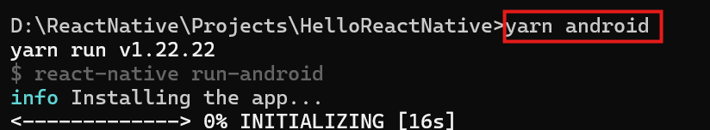
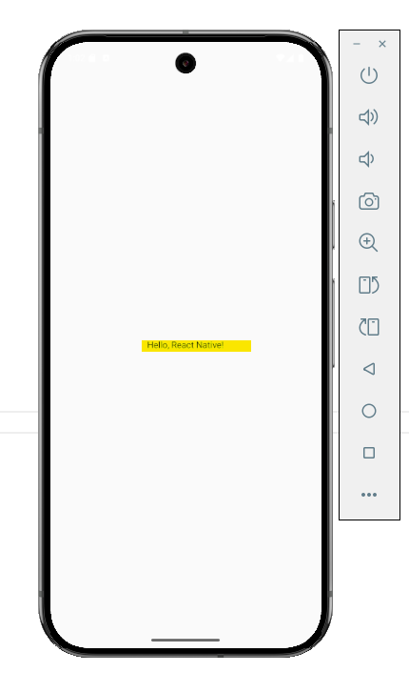
Getting Started with React Native Development
Run the React Native CLI Application
Run the application on the emulator using yarn android
To stop the development server, press Ctrl + C

Slide 19
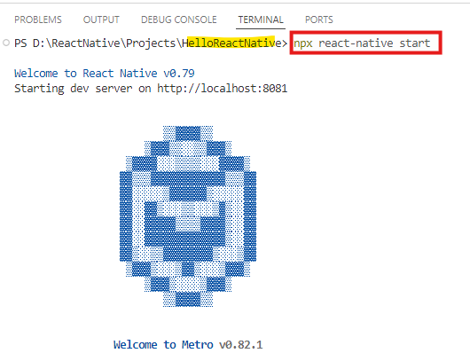
Getting Started with React Native Development
Run the React Native CLI Application using Metro
We can also run a React Native CLI application using Metro
Metro is the JavaScript bundler and development server used by React Native
Metro plays a central role in the development and execution of a React Native CLI app
When you run npx react-native start, Metro launches a server on a port (usually 8081)
This server is responsible for watching your project files and managing changes
Open a terminal in VS Code and run the command npx react-native start to launch the metro server

Slide 20
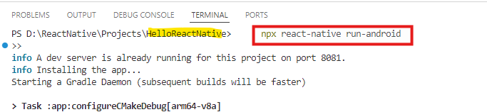
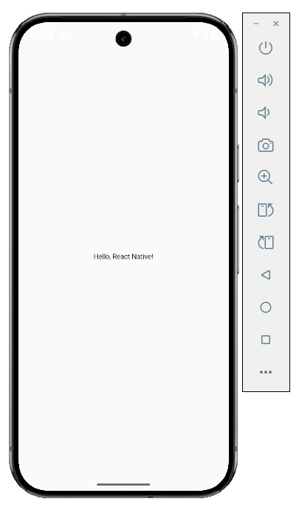
Getting Started with React Native Development
Run the React Native CLI Application using Metro
Then, in a new terminal, run the below command:
npx react-native run-android
The app will be now run on the Android device

Slide 21
Getting Started with React Native Development
Create a Hello React Native CLI Application
It creates a simple React Native application that shows the text “Hello, React Native!” centered on the screen
No extra helper components (Header, Section, etc.) used
Minimal styling and clean structure used
import: Brings in necessary components from React and React Native
App: A functional component that returns a view
<View>: A container that fills the screen
<Text>: Displays a message inside the view
StyleSheet.create: Defines basic styles to center the content

Slide 22
Getting Started with React Native Development
Create a Hello React Native CLI Application
Styling:
The StyleSheet defines how the elements on the screen look and are positioned
The container style:
flex: 1: Fills the full screen.
alignItems: 'center': Centers content horizontally.
justifyContent: 'center': Centers content vertically.

Slide 23
Getting Started with React Native Development
Create a Hello React Native CLI Application
Styling:
flex: 1: Expands the container to fill the available space
alignItems: 'center': Centers children horizontally (cross axis)
justifyContent: 'center': Centers children vertically (main axis)
The default flexDirection is 'column', the main axis is vertical, and the cross axis is horizontal. So,
justifyContent: 'center' centers the content vertically
alignItems: 'center' centers the content horizontally
This combination effectively centers the child components both vertically and horizontally within the container

